Slide 1


Slide 2
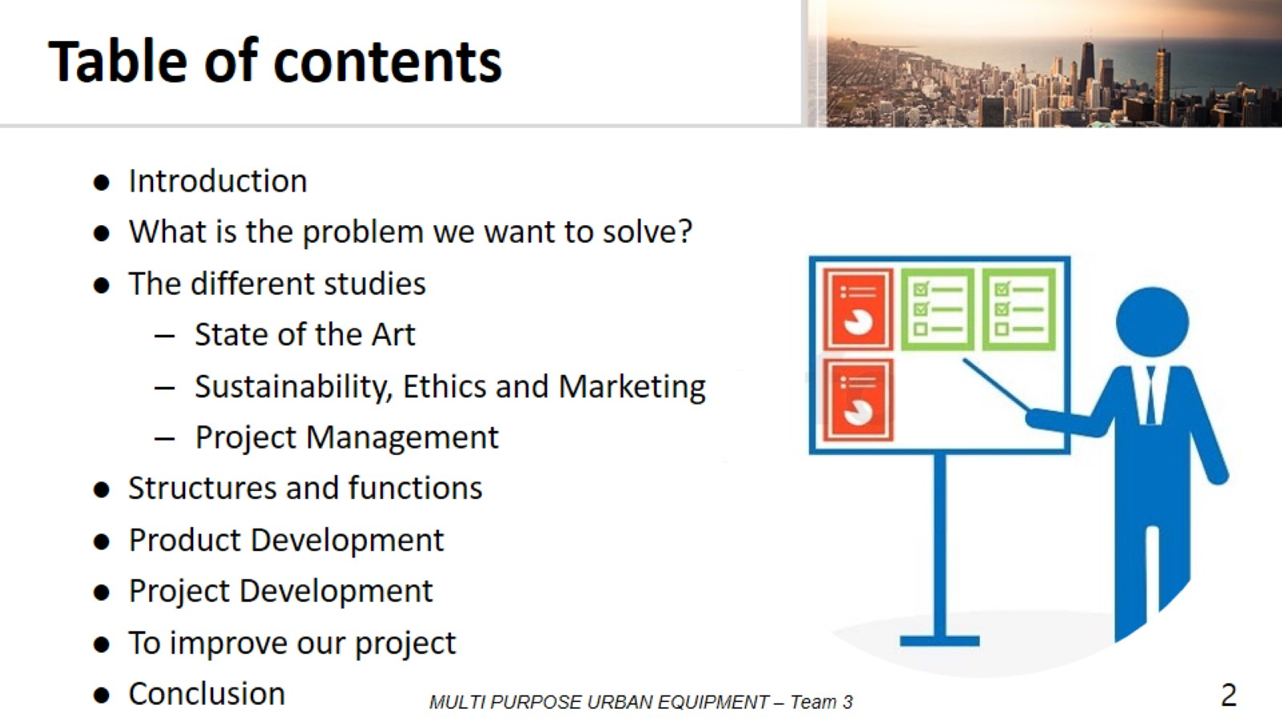
Table of contents

Slide 3
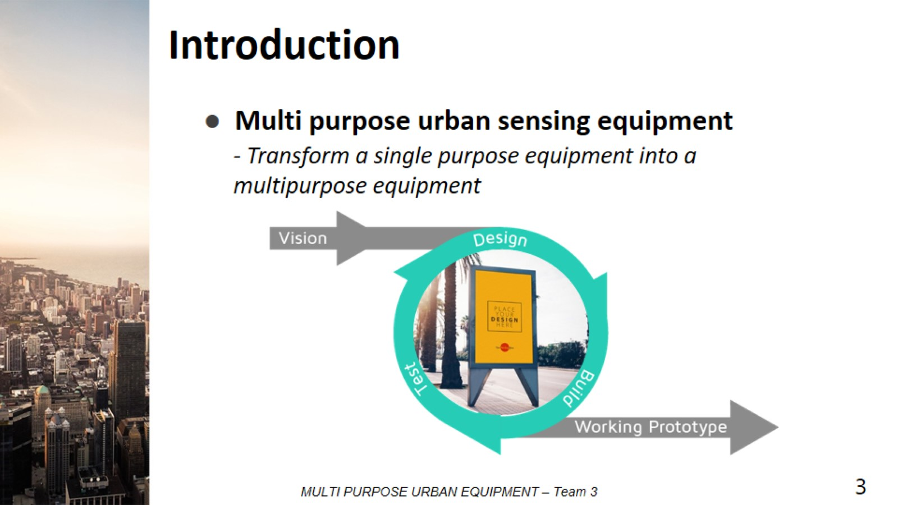
Introduction

Slide 4
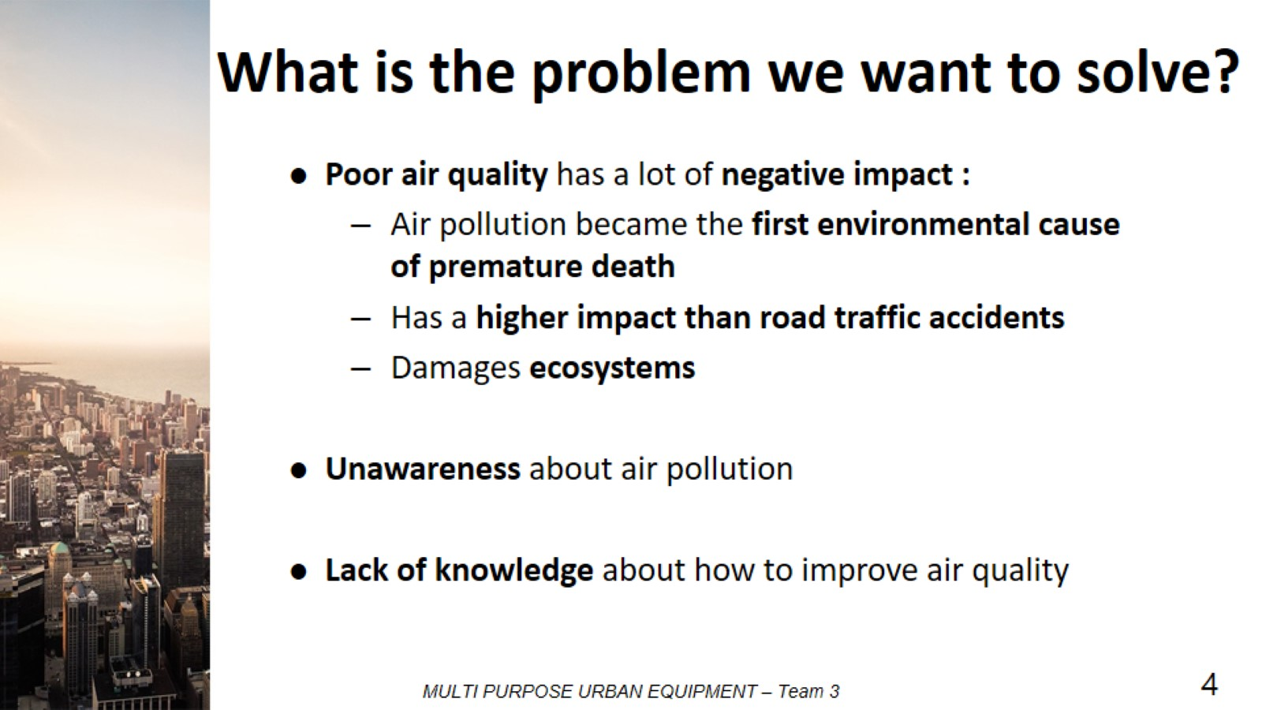
What is the problem we want to solve?

Slide 5
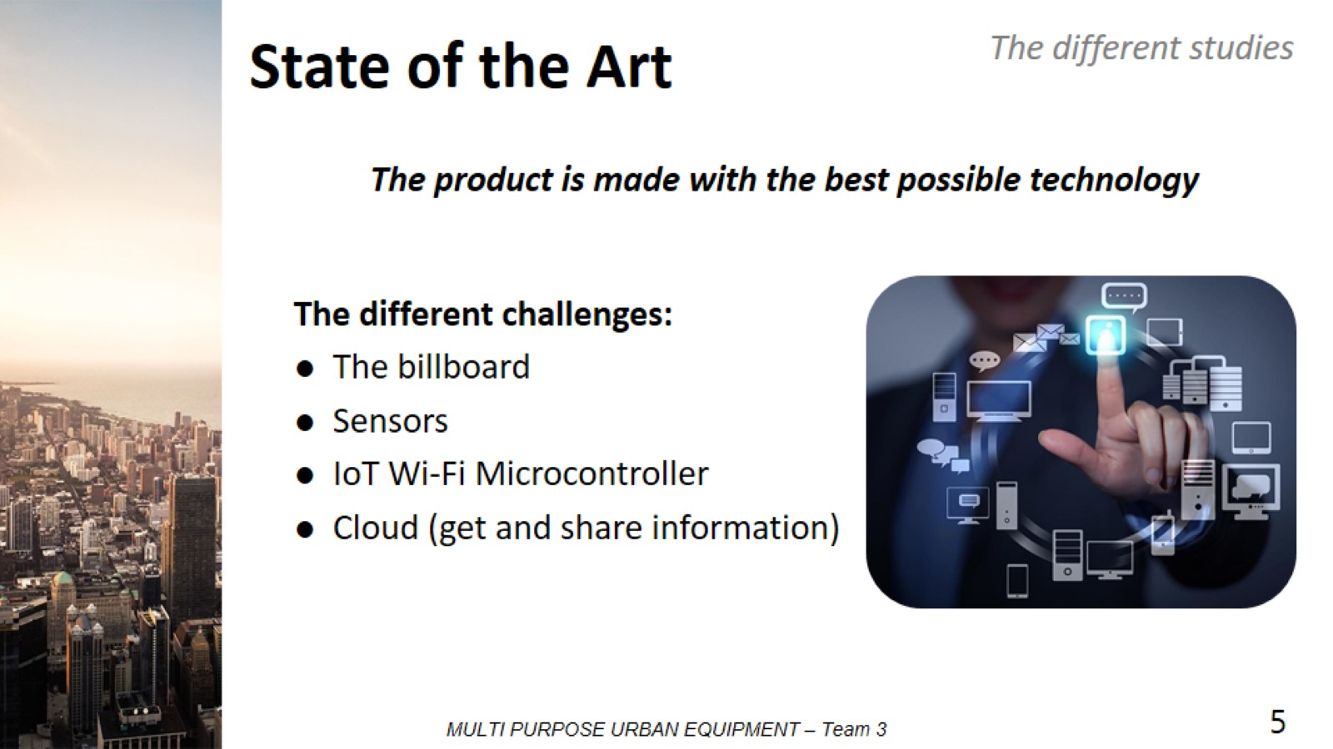
State of the Art

Slide 6

Different studies

Slide 7
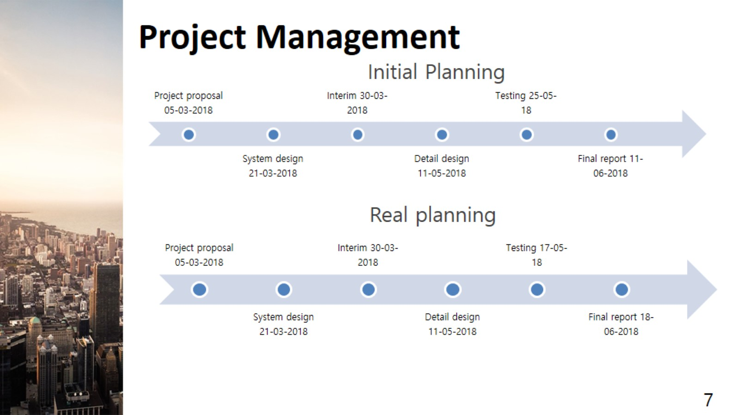
Project Management

Slide 8
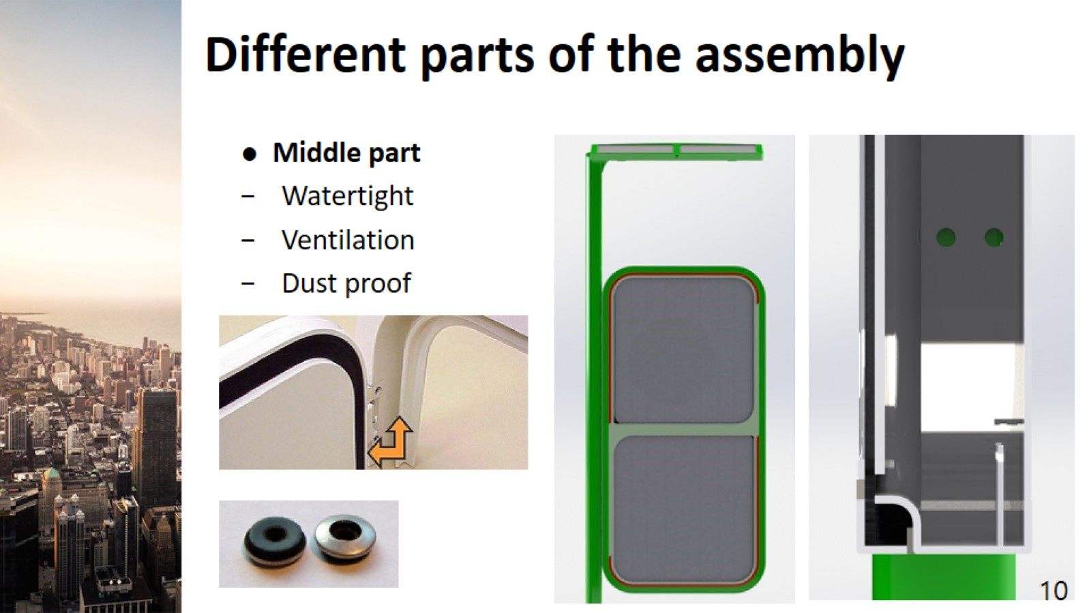
Different parts of the assembly
8

Slide 9
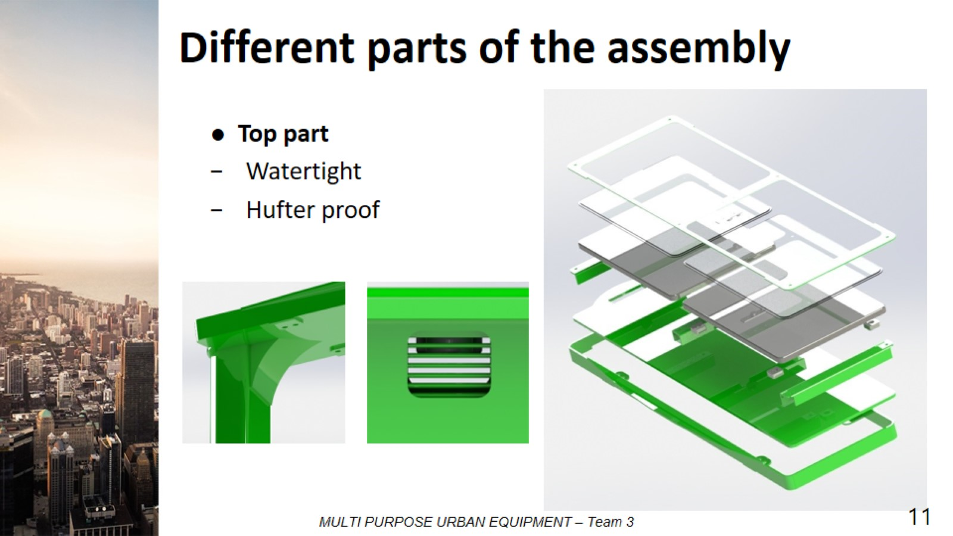
Different parts of the assembly
9

Slide 10
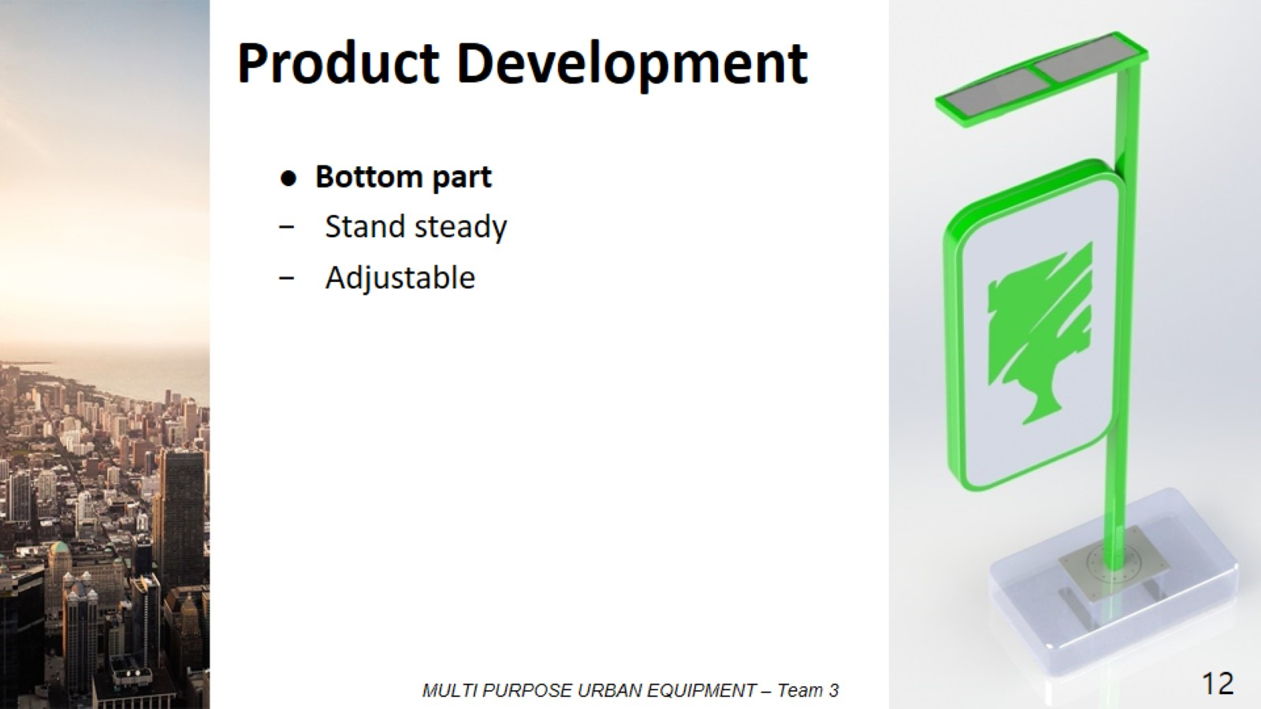
Product Development
10

Slide 11
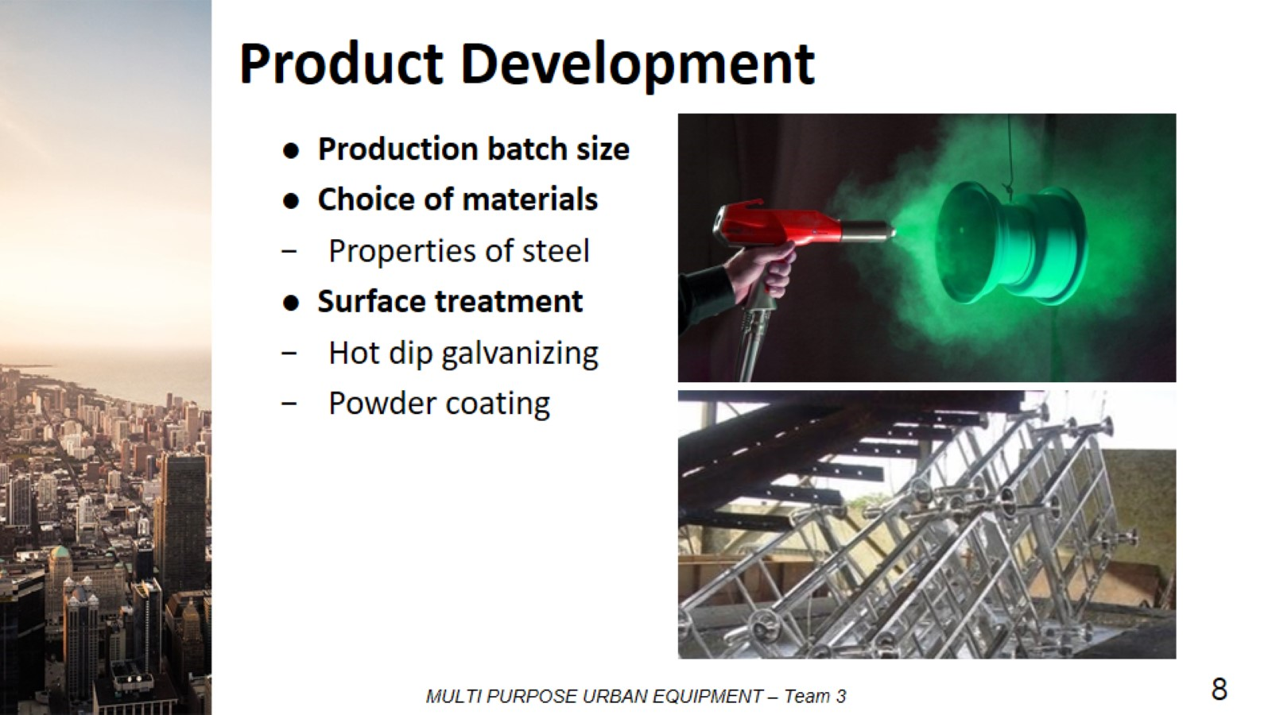
Product Development
11

Slide 12
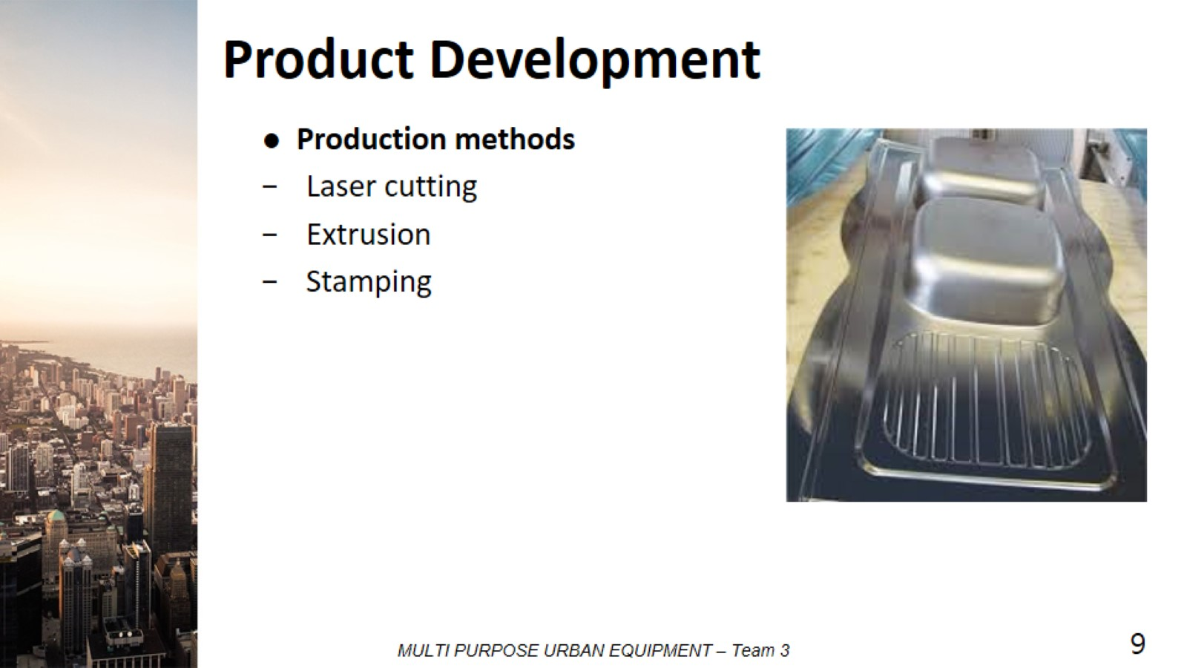
Product Development
12

Slide 13
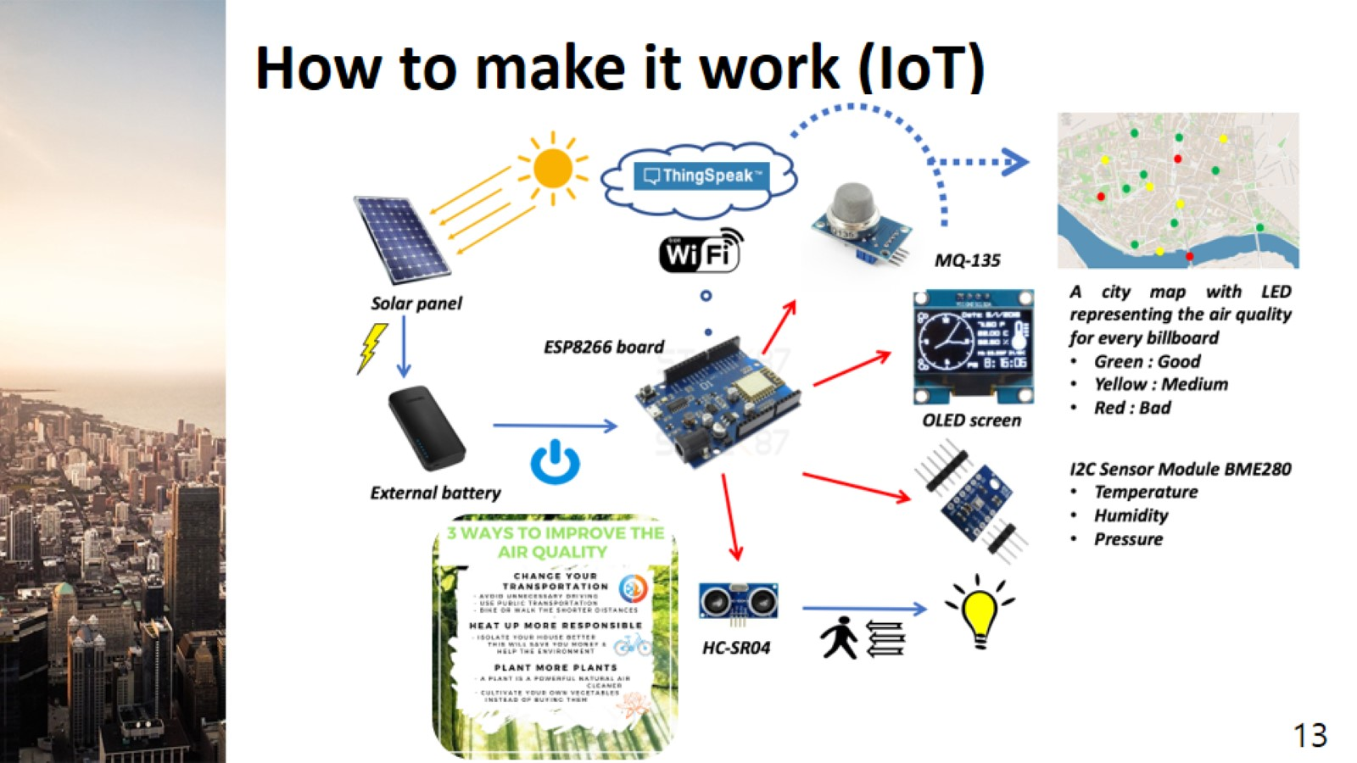
How to make it work (IoT)

Slide 14
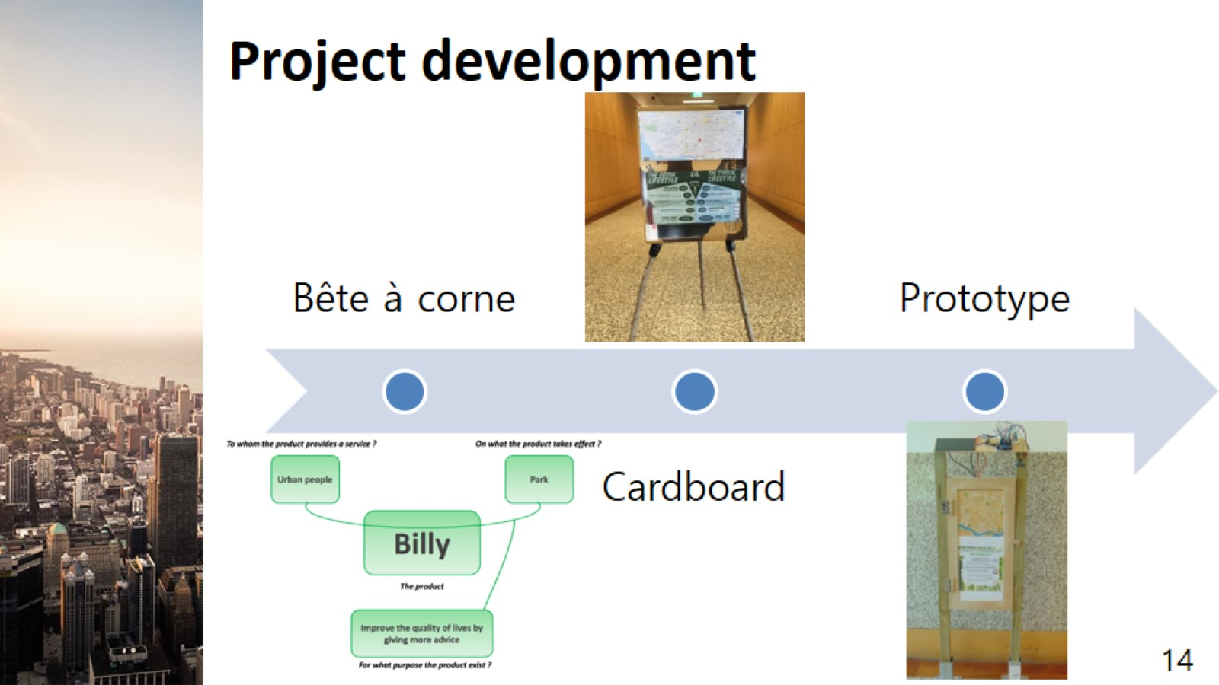
Project development

Slide 15
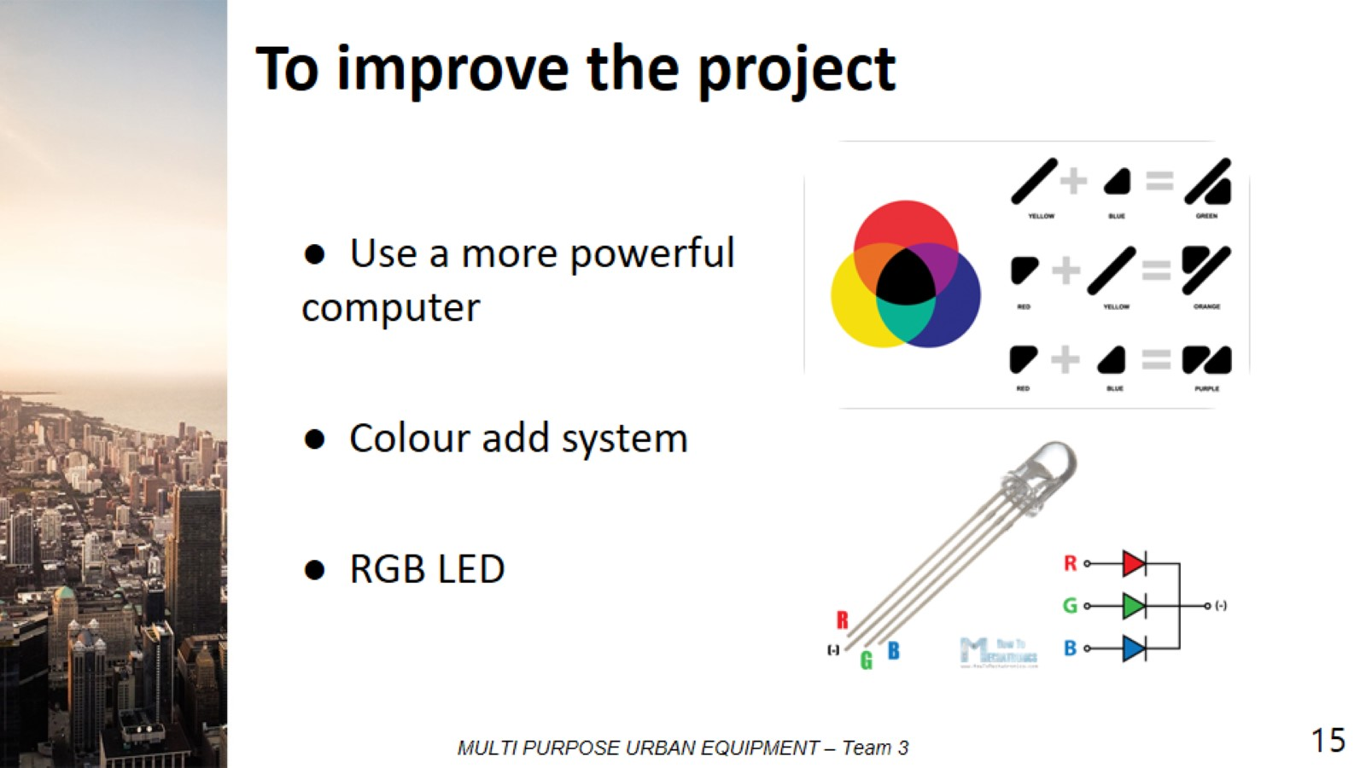
To improve the project

Slide 16
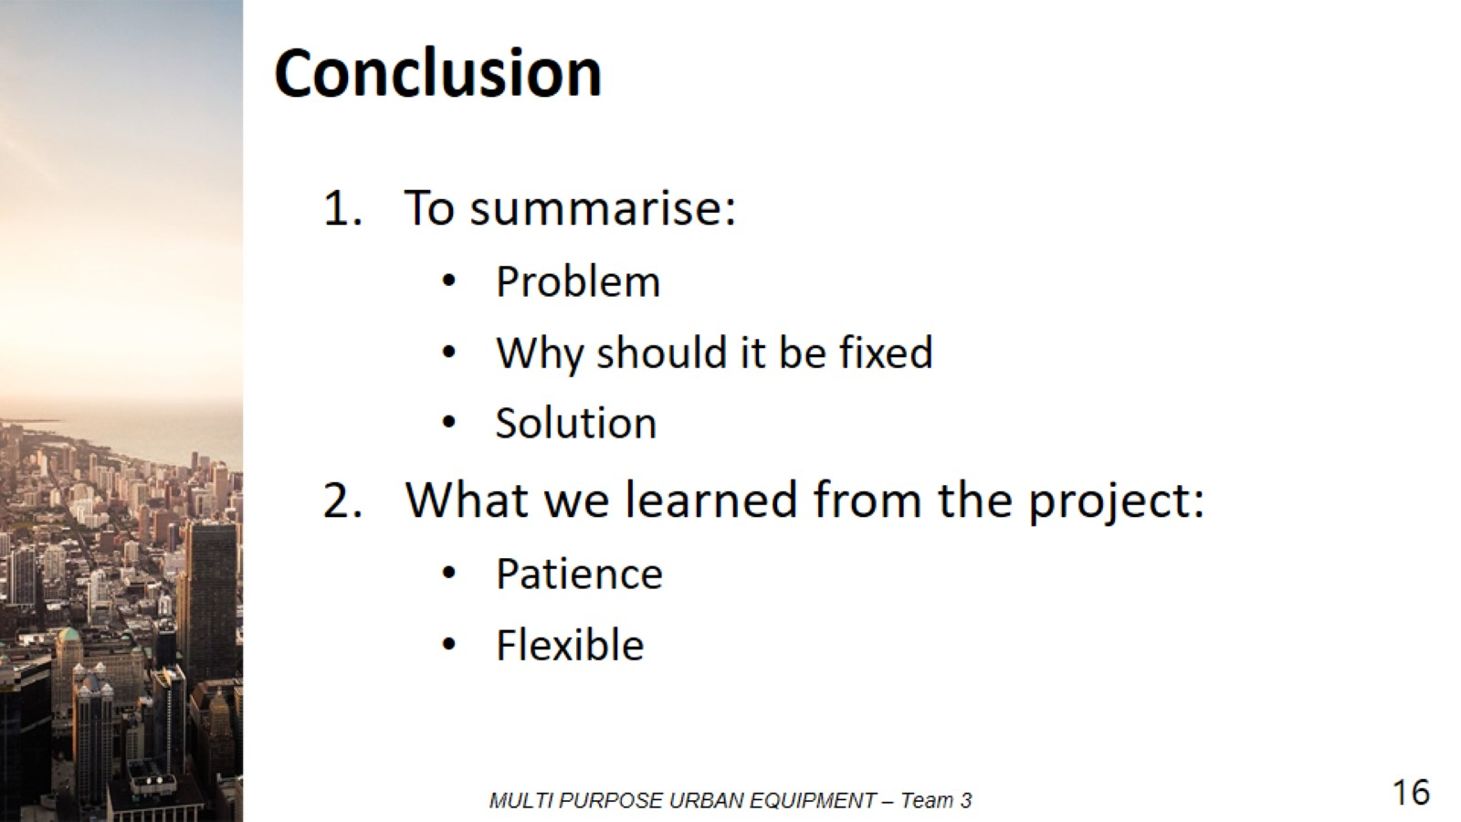
Conclusion

Slide 17

Thank you for your time

