Slide 1


Slide 2
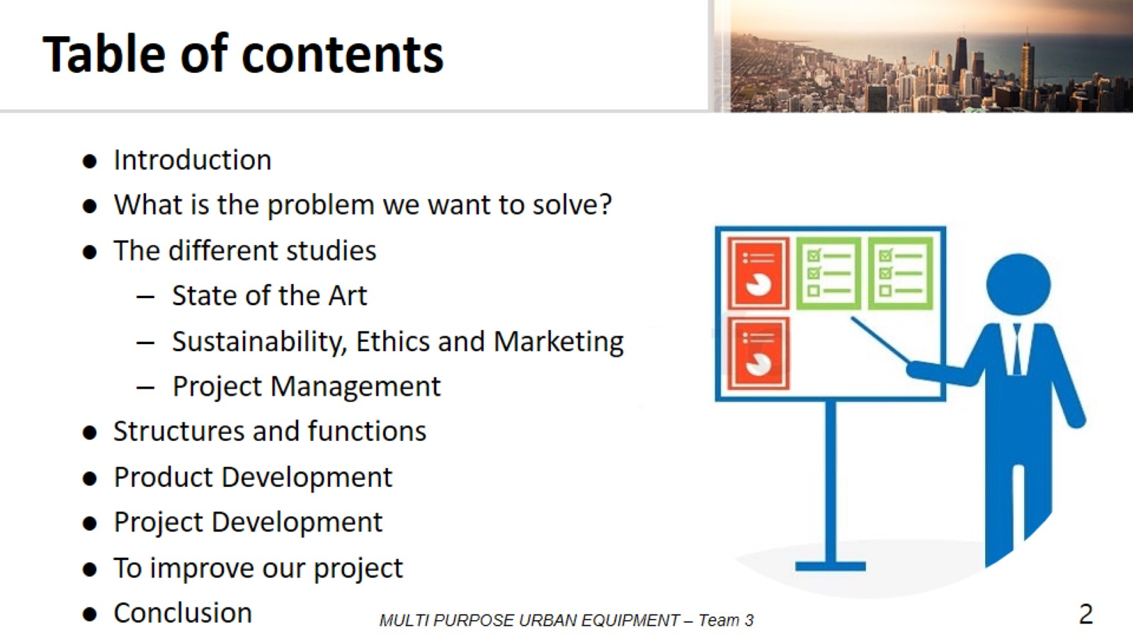
Table of contents

Slide 3
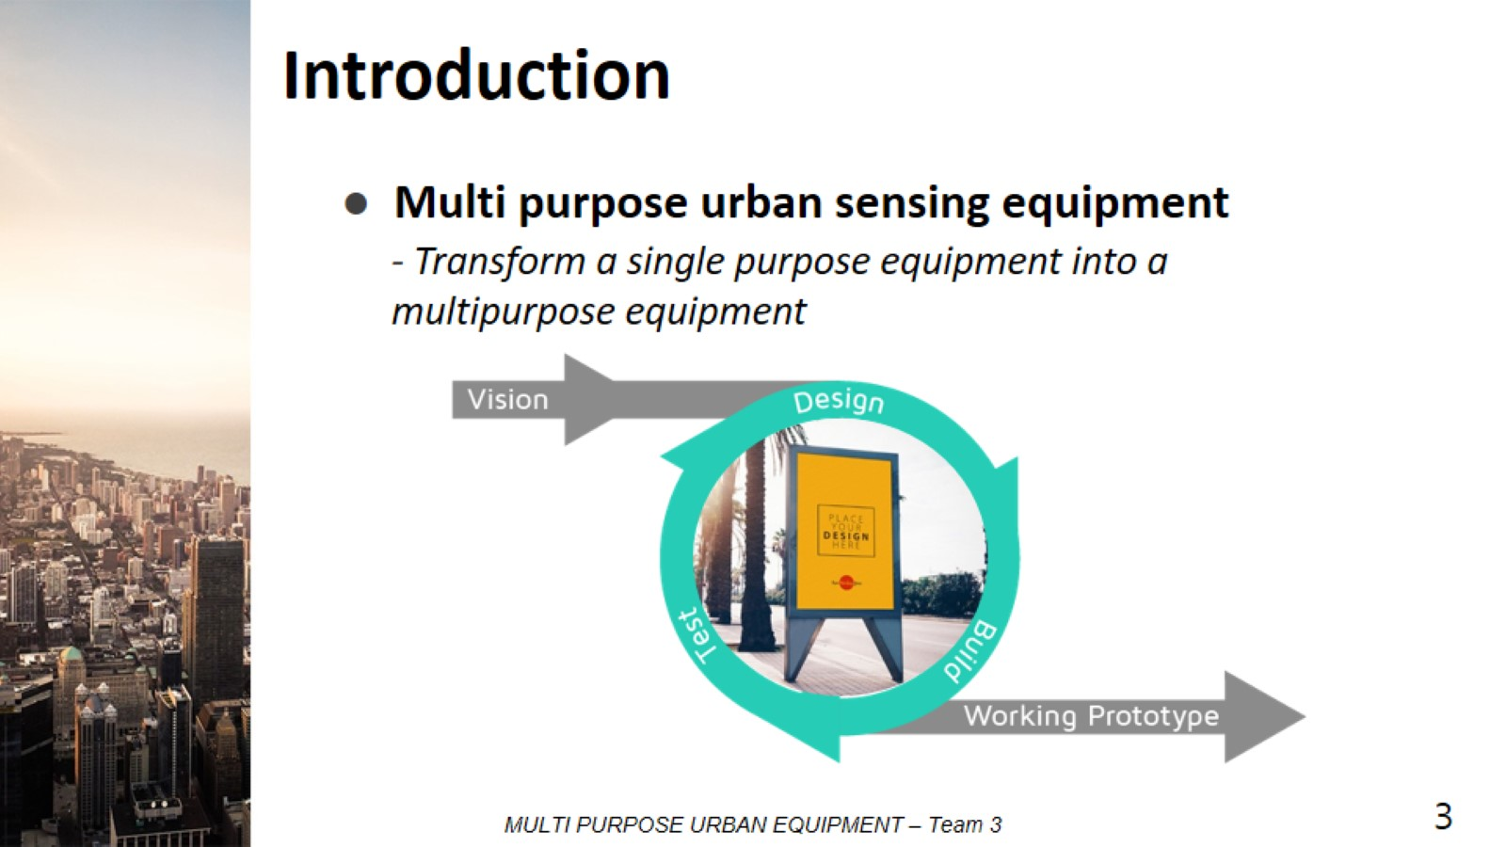
Introduction

Slide 4
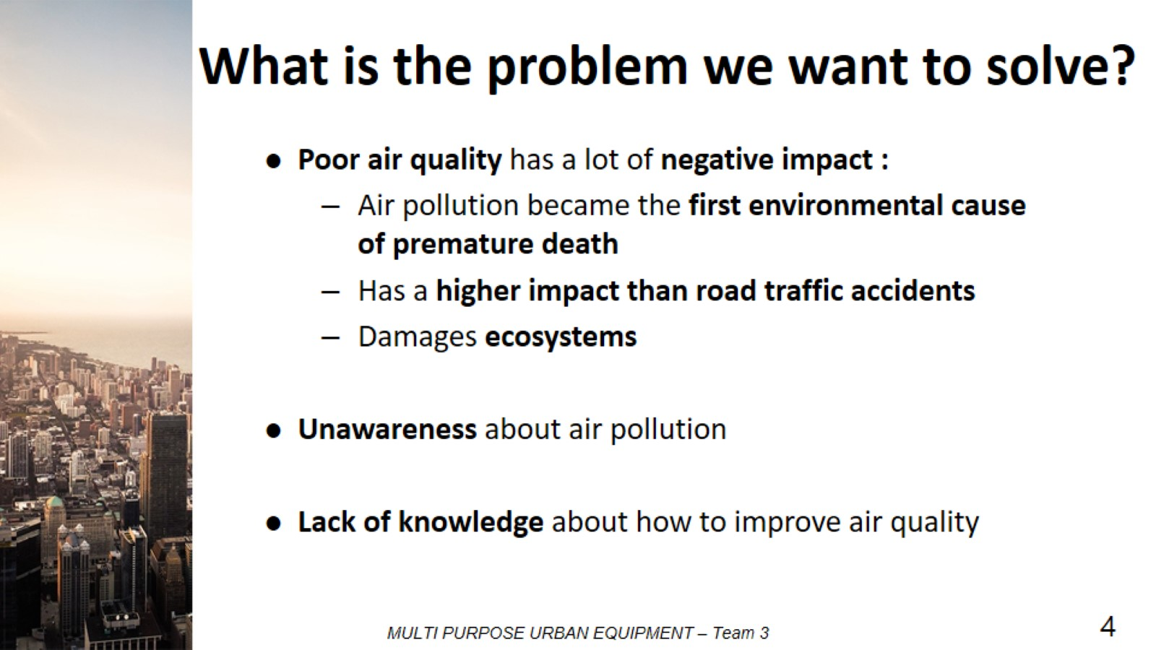
What is the problem we want to solve?

Slide 5
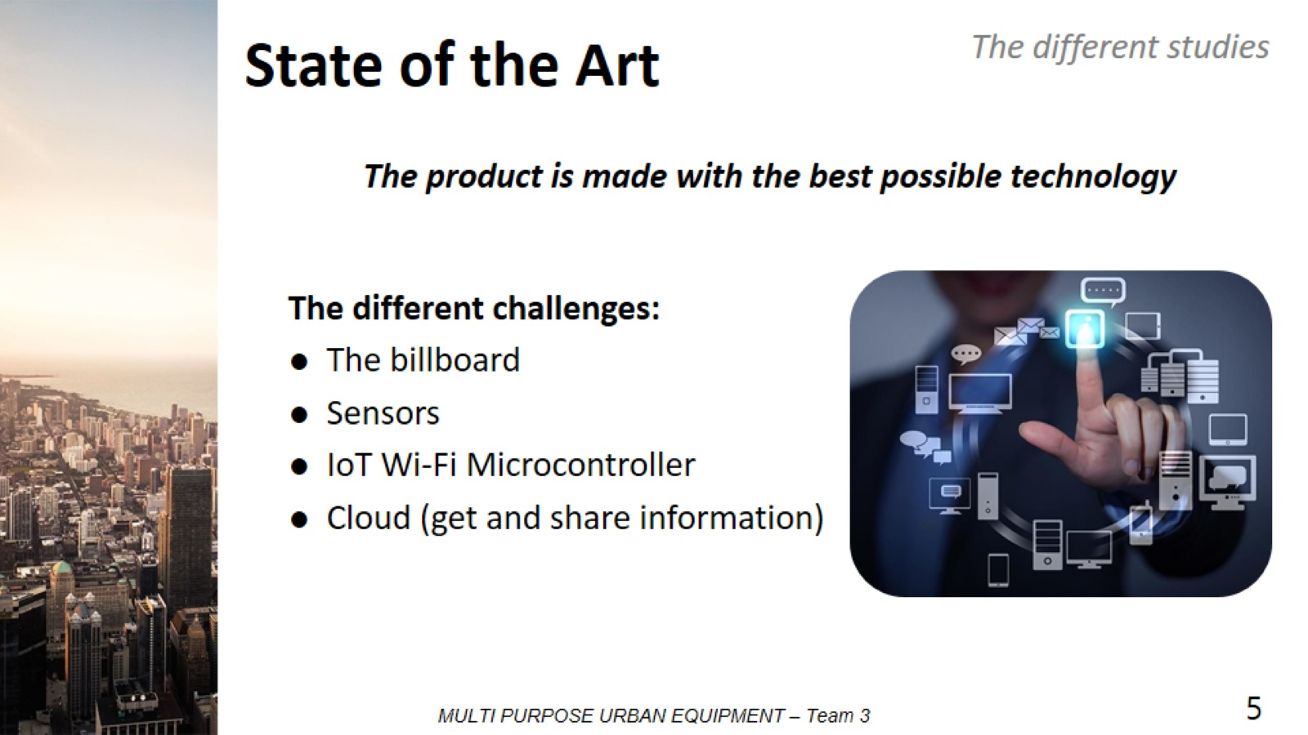
State of the Art

Slide 6

Different studies

Slide 7
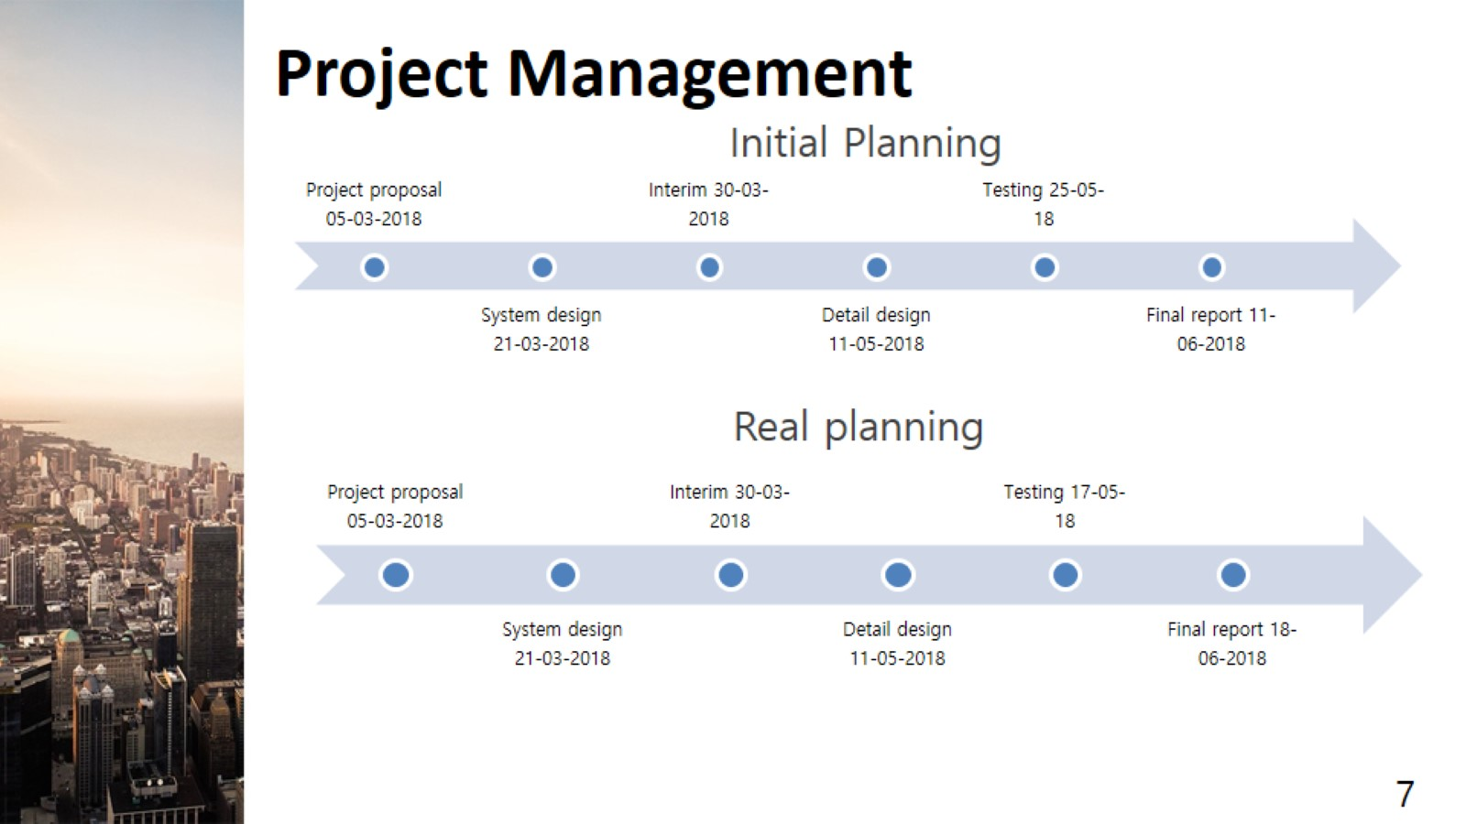
Project Management

Slide 8
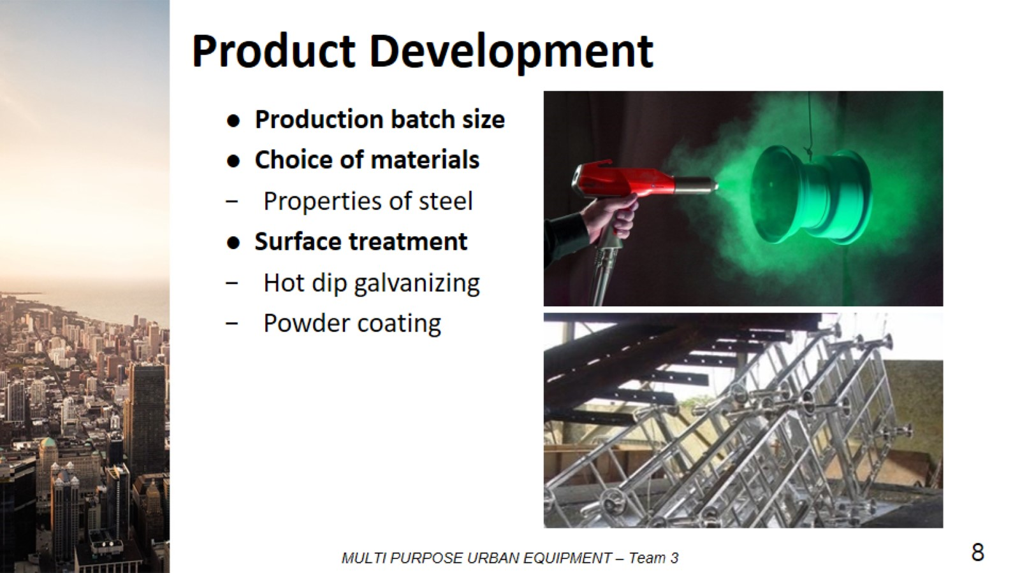
Product Development

Slide 9
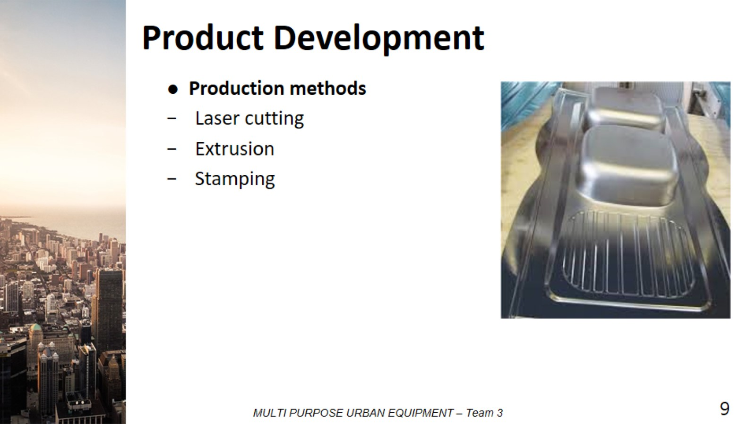
Product Development

Slide 10
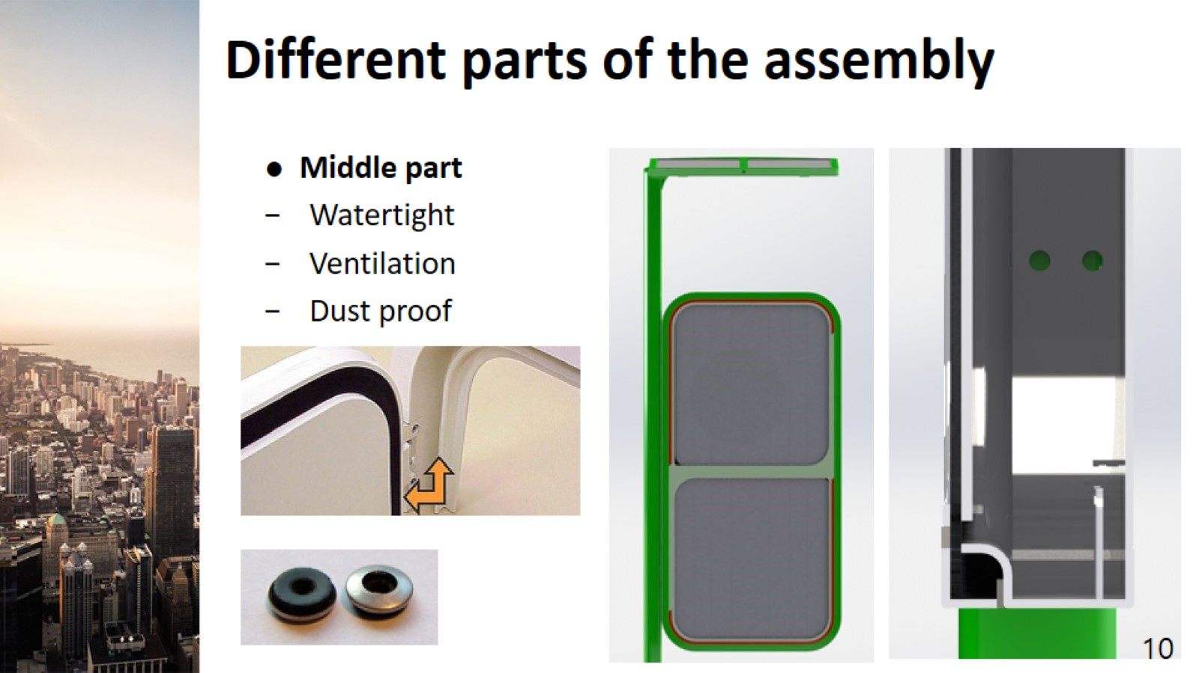
Different parts of the assembly

Slide 11
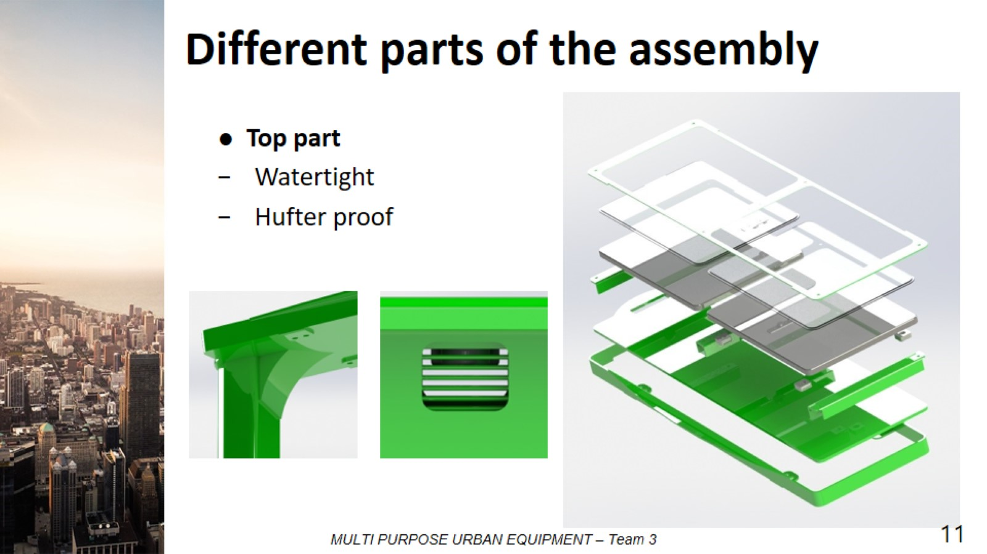
Different parts of the assembly

Slide 12
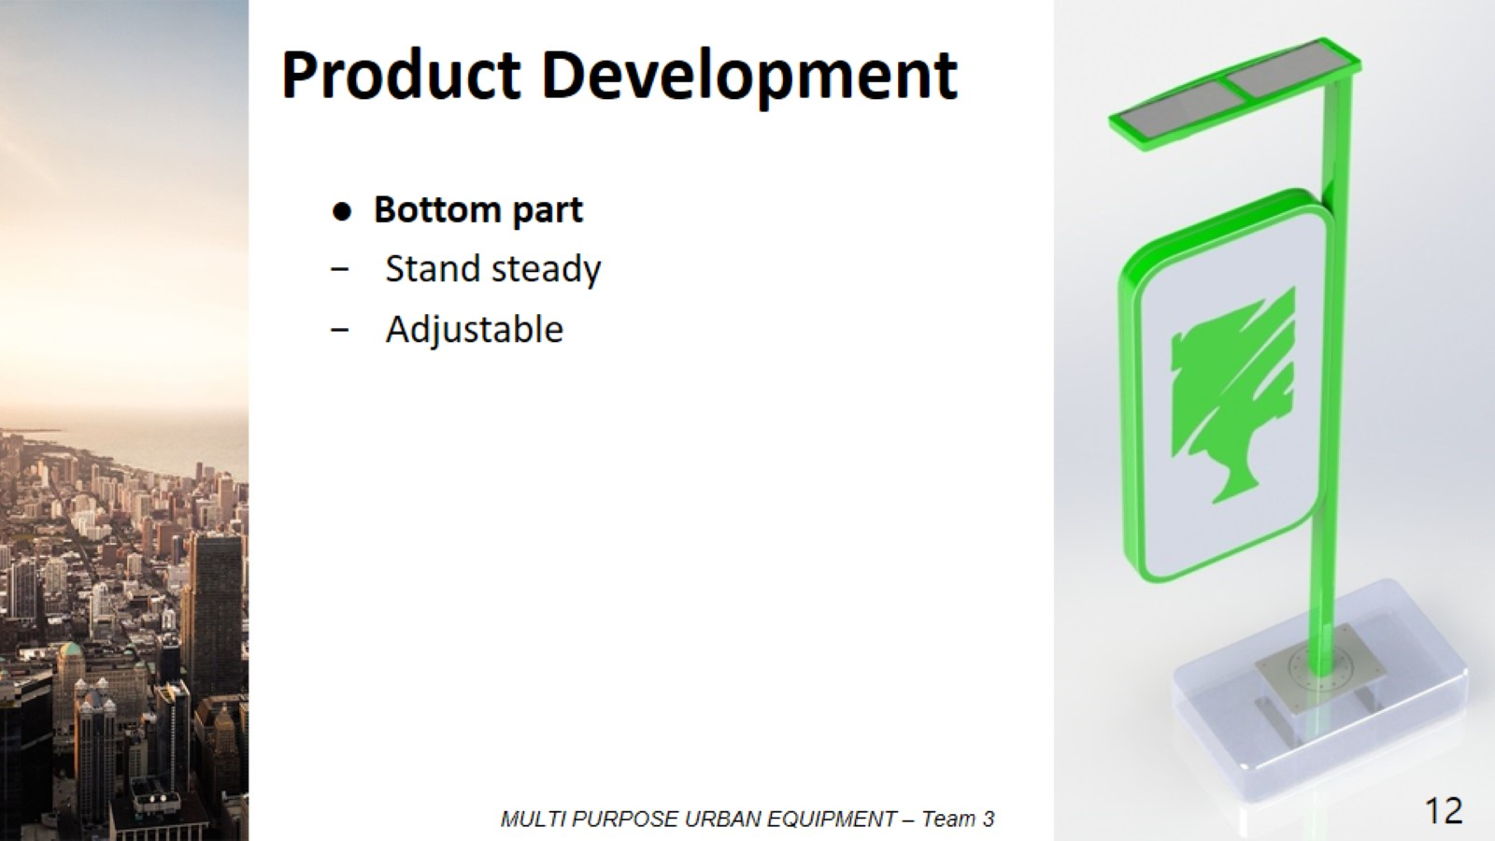
Product Development

Slide 13
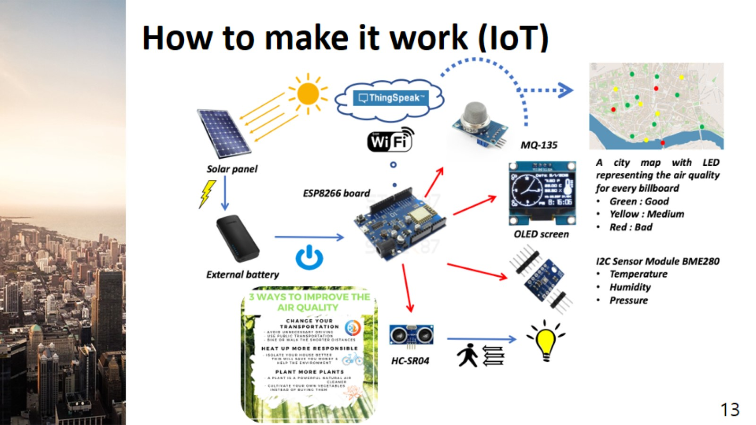
How to make it work (IoT)

Slide 14
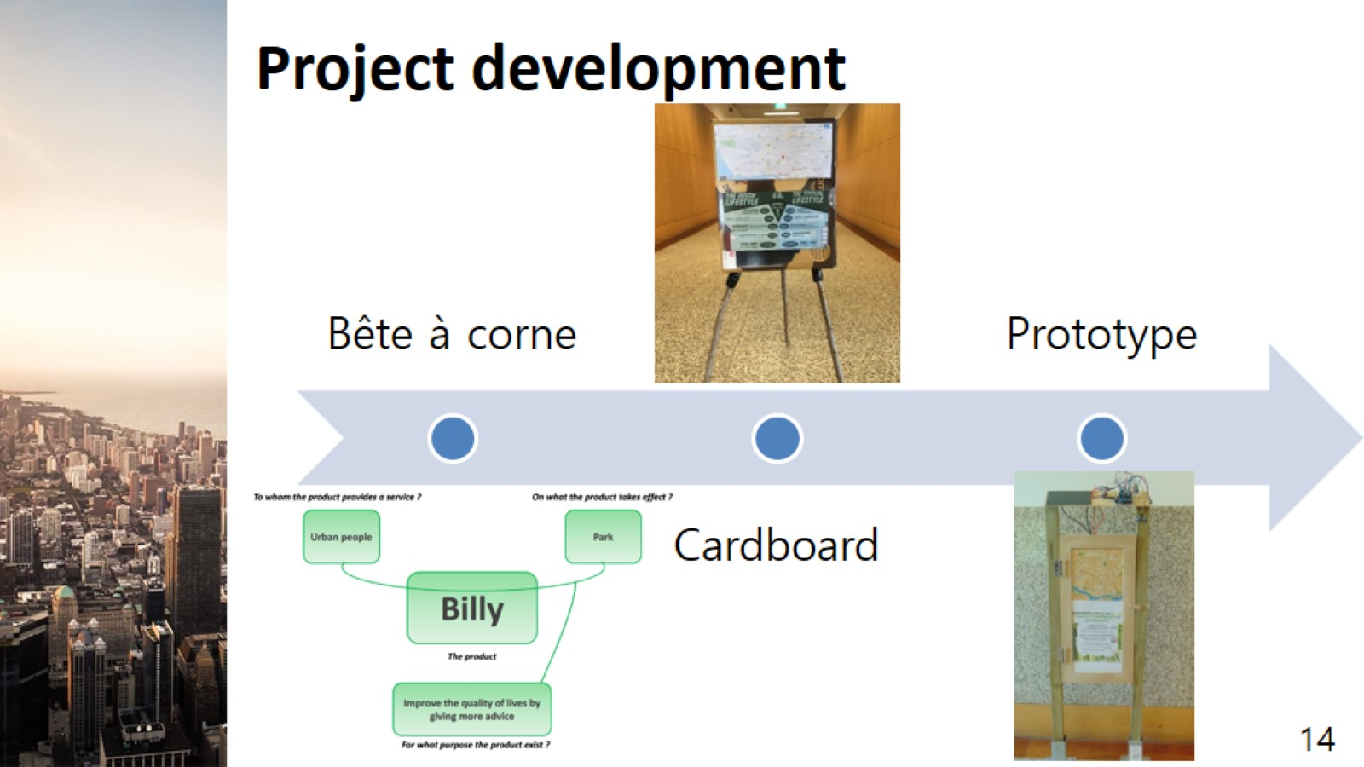
Project development

Slide 15
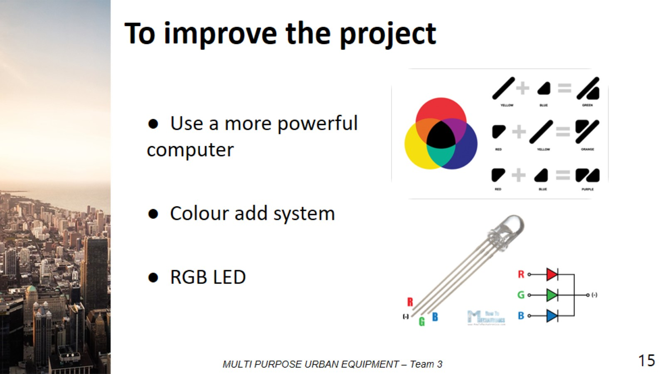
To improve the project

Slide 16
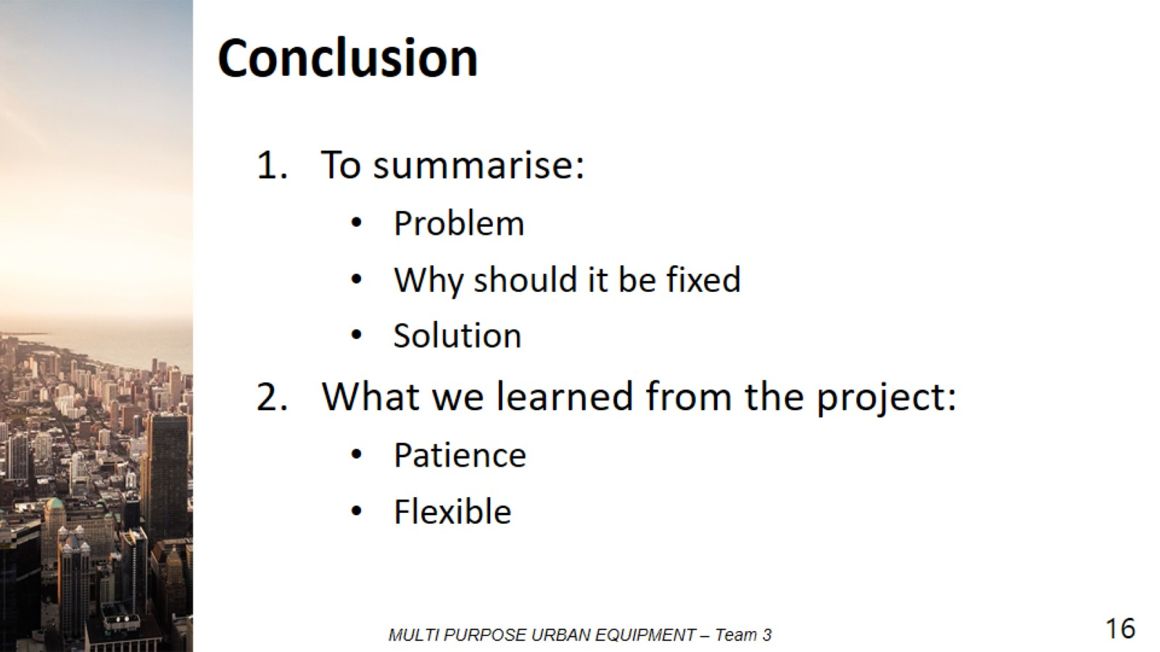
Conclusion

Slide 17

Thank you for your time

