Slide 1


MULTI PURPOSE URBAN EQUIPMENT
INTERIM PRESENTATION
Mostafa Farrag, Maarten van der Most, Maria Bagiami, Damien Cordeiro Marques & Wouter Smit

Slide 2

Table of contents
● Introduction
● What is the problem we want to solve?
● The different studies
  State of the Art
  Sustainability
  Ethics
  Marketing
● Structures and functions
● To improve our project
● Conclusion
1
MULTI PURPOSE URBAN EQUIPMENT – Team 3

Slide 3
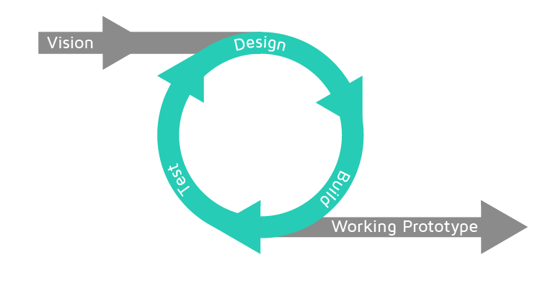
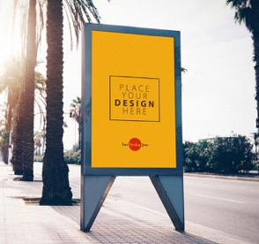
Introduction
● Multi purpose urban sensing equipment
- Transform a single purpose equipment into a multipurpose equipment
2
MULTI PURPOSE URBAN EQUIPMENT – Team 3

Slide 4
What is the problem we want to solve?
● Poor air quality has a lot of negative impact :
  Air pollution became the first environmental cause of premature death
  Has a higher impact than road traffic accidents
  Damages ecosystems
● Unawareness about air pollution
● Lack of knowledge about how to improve air quality
3
MULTI PURPOSE URBAN EQUIPMENT – Team 3

Slide 5
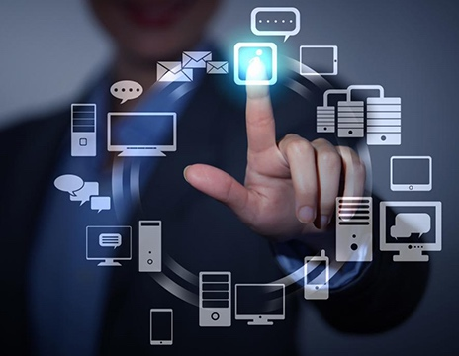
State of the Art
The different studies
The product is made with the best possible technology
The different challenges:
● The billboard
● Sensors
● IoT Wi-Fi Microcontroller
● Cloud (get and share information)
4
MULTI PURPOSE URBAN EQUIPMENT – Team 3

Slide 6
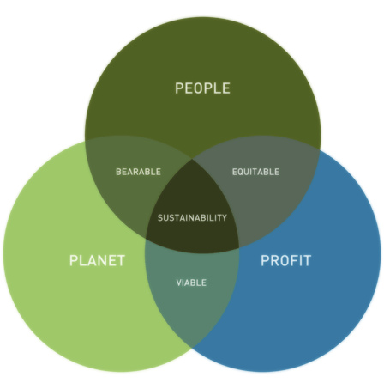
Sustainability
The different studies
  Protect people from air pollution
  Advise people on what they can do
  Solar
  powered
    Decreasing healthcare cost
    Preventing fines from the EU
  Materials which can be re-used
5
MULTI PURPOSE URBAN EQUIPMENT – Team 3

Slide 7
Ethics
The different studies
● Engineering Ethics
  Humans
  Society
  Environment
● Sales and Marketing Ethics
  Advertising
● Environmental Ethics
  Local
  Fair work
● Liability
  Defects policy
  Quality/safety
6
MULTI PURPOSE URBAN EQUIPMENT – Team 3

Slide 8
Marketing
No serious business experience
Different languages
Limited time
Limited budget
Different expertise
Lot of flexibility
Fast and dynamic market
Strong competitors
EU new legislation about air quality
7

Slide 9
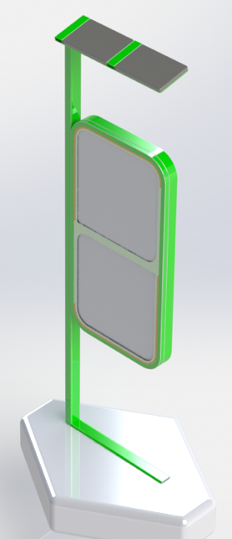
Characteristics
Structure and functions
● Billy, the smart defined billboard
For city parks
Sustainable and ecological design
● It will measure
Air pollution
Pressure
Humidity
Temperature
● Billy will share
Information on the cloud
Information and advice with urban people
8
MULTI PURPOSE URBAN EQUIPMENT – Team 3

Slide 10

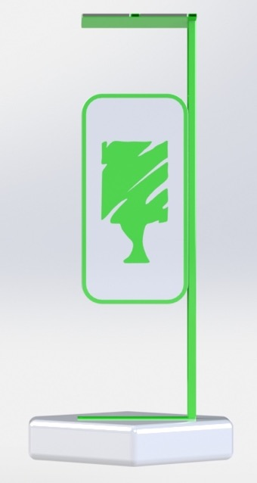
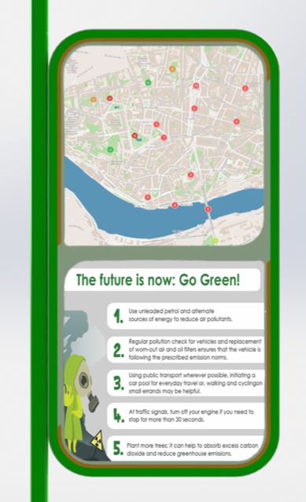
Design & Features
9
MULTI PURPOSE URBAN EQUIPMENT – Team 3

Slide 11

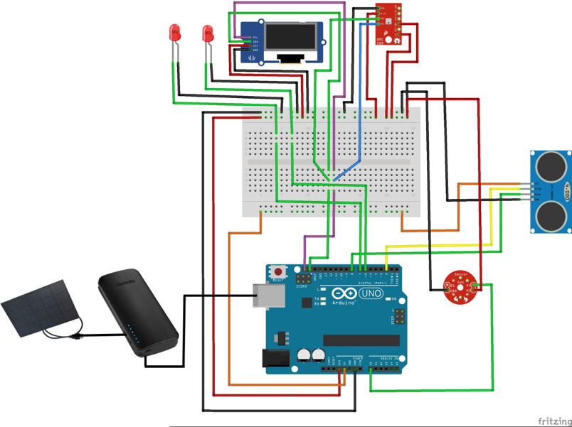
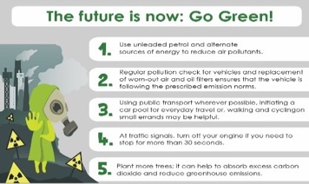
How to make it work (IoT)
City map printed with a LED for each park
OLED
BME 280
Detecting sensor
Dust sensor
Solar panel
Battery
ESPduino IoT controller
10
MULTI PURPOSE URBAN EQUIPMENT – Team 3

Slide 12
To improve the project
● Use a more powerful computer
● Use interactive screen instead of a printed map and a list of advice
● Use different types of sensors (quality)
● Improve product details
11
MULTI PURPOSE URBAN EQUIPMENT – Team 3

Slide 13
Conclusion
To summarise:
  Problem
  Why should it be fixed
  Solution
What we learned from the project:
  Patience
  Flexible
12
MULTI PURPOSE URBAN EQUIPMENT – Team 3

Slide 14
Thank you for your time
Time for questions
13
MULTI PURPOSE URBAN EQUIPMENT – Team 3

